Slide 1
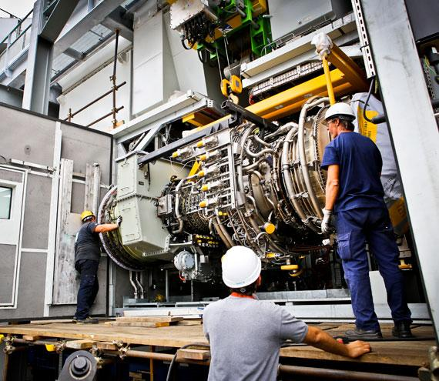
Blending Facility Proposal

Slide 2
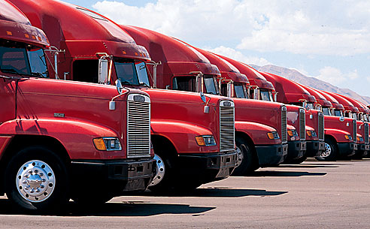
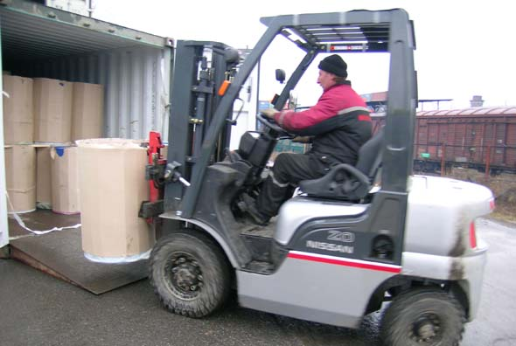


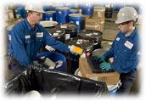
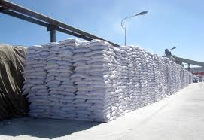
Vision
Formation of a highly reputable local blending facility that provides numerous products, services & solutions to industry for Algeria and Africa region.
Supporting these activities by maintaining fully equipped facilities, including Laboratory, sizable warehousing & offices.
Key operations need to be in place while leaving a multitude of important tasks to this Organization, examples include:
Sales & Marketing
Customs Clearance & Forwarding
Financial Services
Infrastructure & Logistical Support such as offices & warehousing, transportation & delivery, personnel and general management

Slide 3
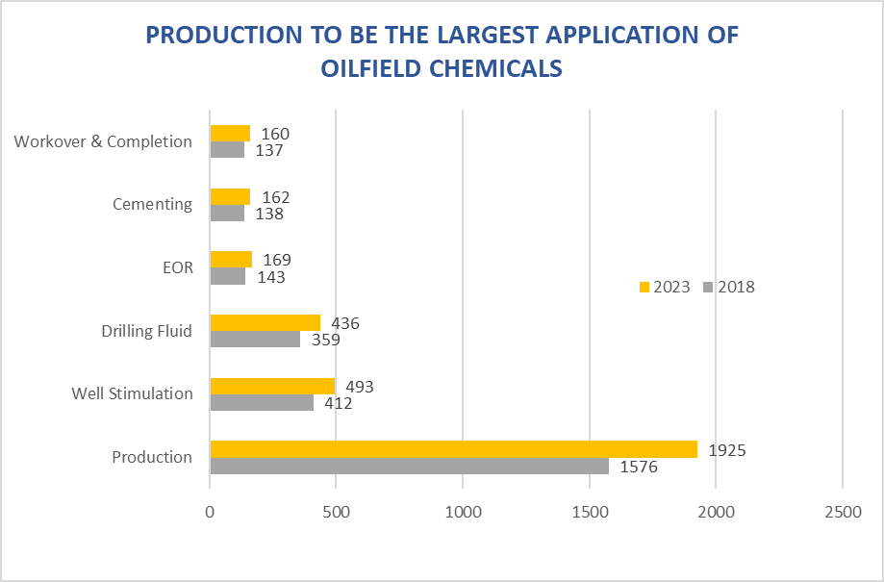
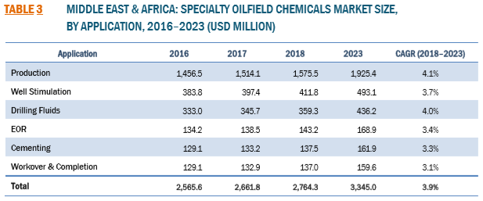
Oilfield Chemicals Market Size

Slide 4
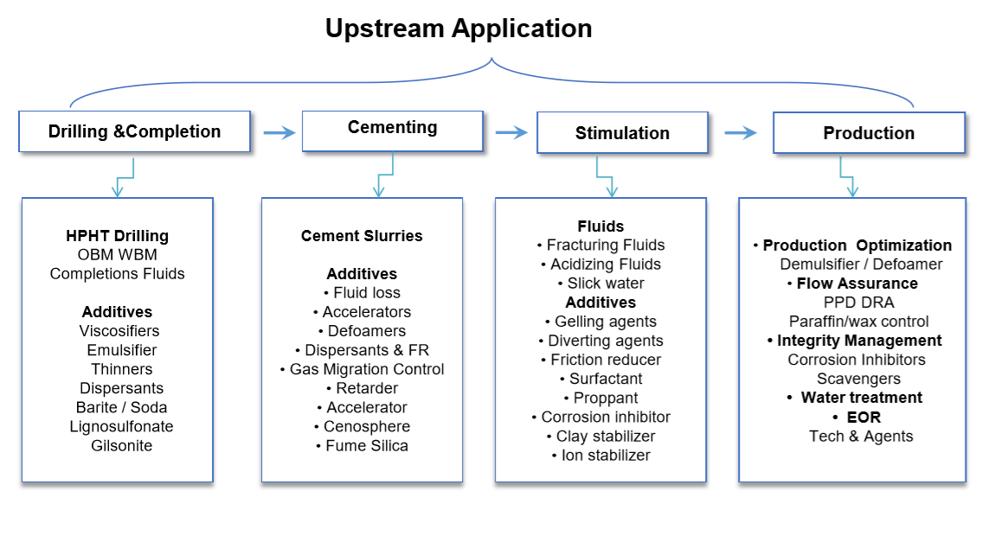
Oilfield Chemicals Segments

Slide 5
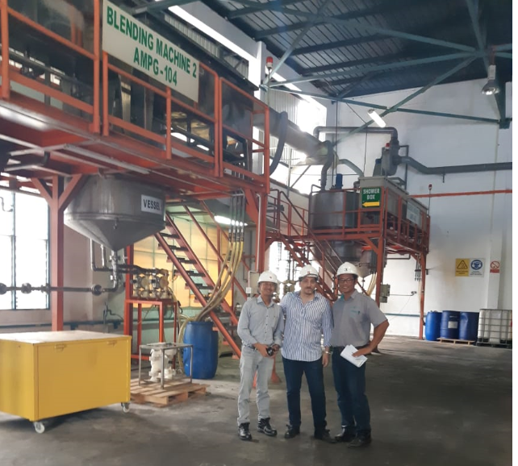
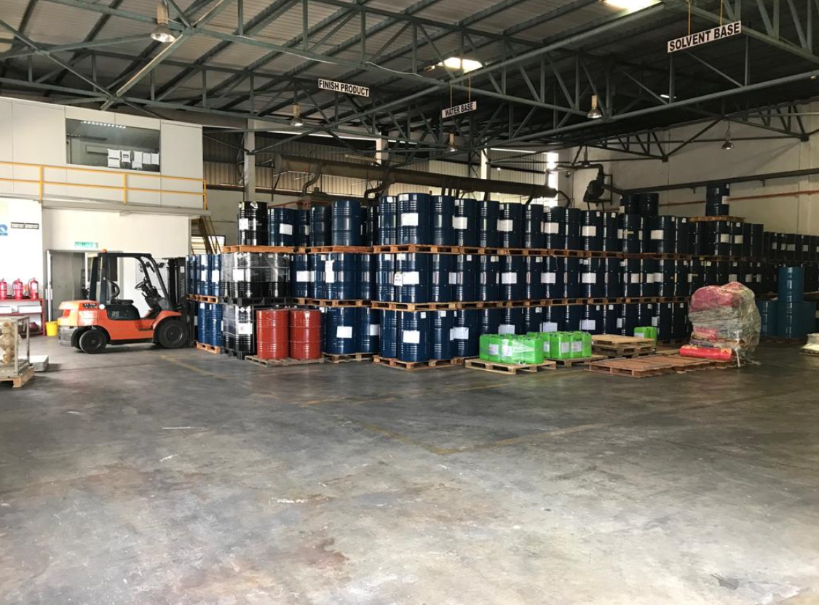
Chemical Blending Roadmap
You can start with a simple Small to Medium Size “Fit for Purpose” Blending Facility in total $400k-$500K.
You need a covered area with 2-3 Blenders and storage area as below.

Slide 6
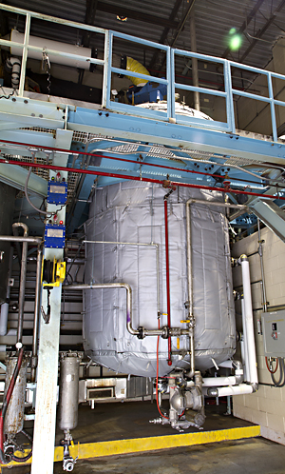
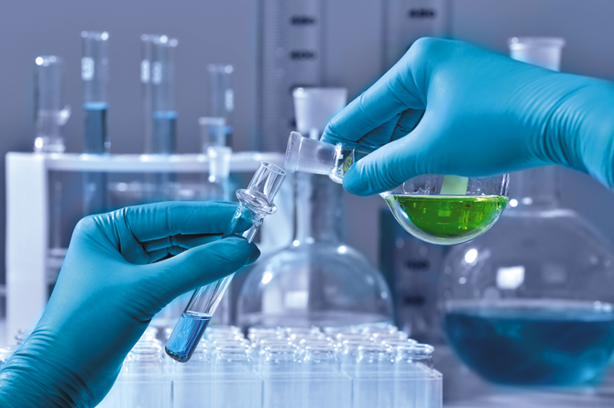
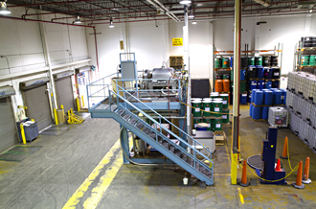
Chemical Blending Roadmap
Phase 1
Blending
Chemical mixing
Dispersions & Emulsions
Focus on Production chemicals & Drilling Products
Analytical capabilities and product customization
Phase 2
Blending and Chemical Reactions
Creating new molecular entities through chemical reactions of gaseous, liquid or solid raw materials
Advance analytical capabilities
Phase 3
Product Development
Synthesis and process development
Applications testing lab
Scale up and pilot plant facilities

Slide 7
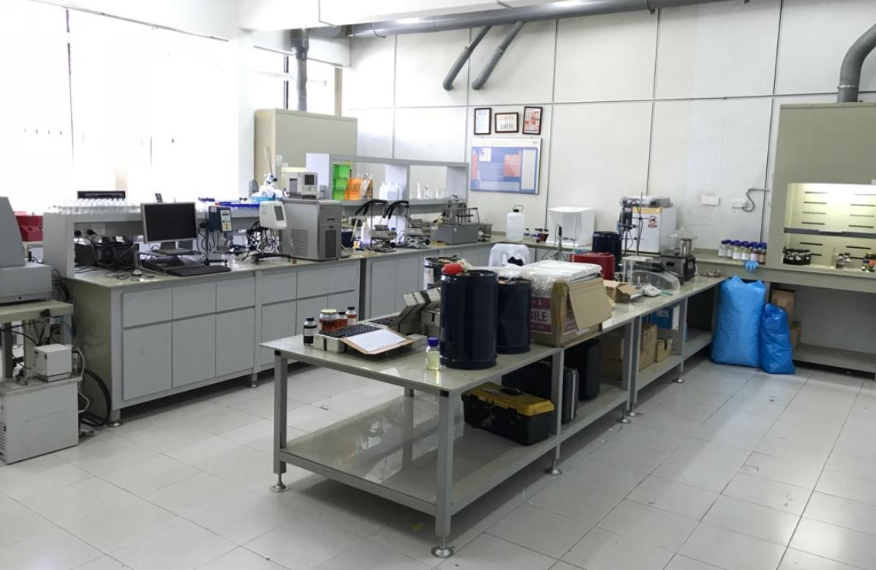
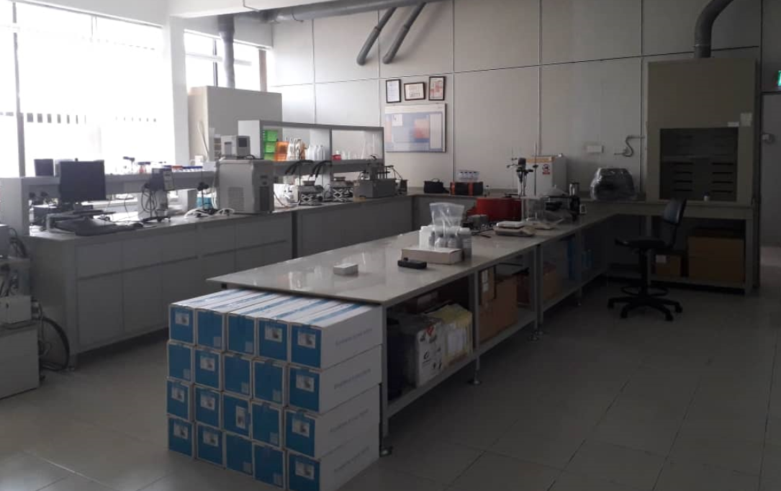
Laboratory
Full Range Laboratory can be set up which will take care of the Production Chemicals as well as Quality testing like Barite, Bentonite, Calcium Carbonate, Liquid Blending, Solid Blending and all related mud additive used in Water Base Mud, Oil Base Mud, etc.
Lab will be built to do Quality Test, Customization of Products specifically for Demulsifiers and Future product development.
Size 300 sqft. Below is an example.

Slide 8
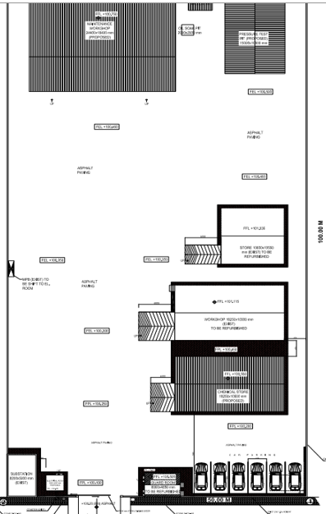
Proposed Layout.
Ideally we should have 10,000 sq M land for such project especially if we want to go for Phase 2 expansion.
If not available, 5000 sq M can be sufficient even for future expansion.

Slide 9
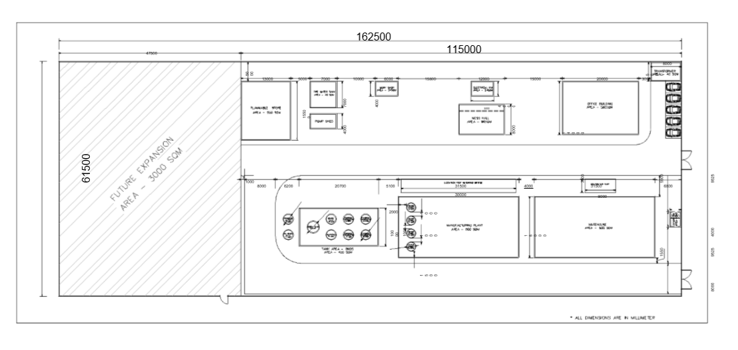
Proposed Layout for a Medium to Large Blending Facility

Slide 10
R&D Based Developed Production Specialty Chemicals
List of Chemicals
Temperature Stabilizer
ROP ENHANCER
CLOUD POINT GLYCOL – MEDIUM, HIGH, LOW.
Drilling Detergent
Liquid PAC, Xanthan Gum, HEC
Rig Wash
HT Thinner
Silicate Lubricant
CMS
Liquid PHPA
Demulsifier
List of Drilling Chemicals
Liquid Gilsonite
Primary & Secondary Emulsifiers
OBM Wetting Agent
OBM Thinner
OBM Rheology Modifier
Water Soluble Lubricant ofr Brines
Polyamine Shale Inhibitor
Dofoamers (Alcohol, Silicone & Glycol based)
And many others…

Slide 11
Plant Equipment
Sl. No. | Requirements | Required No | Approximate Cost in USD
1 | 20 KL Storage tanks | 3 | 100,000
2 | Platform | - | 40,000
3 | Load Cells & Weighing Scales | - | 20,000
4 | Fork Lifts | 2 | 40,000
5 | Trolleys & Drum Lifters | - | 15,000
6 | DG | 1 | 35,000
7 | Lab Equipments | - | 75,000
8 | Ramps | 2 | 40,000
9 | Automated Filling Machines | 2 | 35,000
10 | Truck | 1 | 50,000
11 | Blenders | 4 | 128,000
Total Cost excluding Land Cost & Building Cost |  |  | USD 578,000

Slide 12
Summary Investment requirement of Small Fit for Purpose Blending Facility
Chemical Plant
Production Unit Equipment | USD 0.5 Million
Potable Cabins and Closed Shaded Area | USD 0.3 Million
Opex for Year 1 | USD 0.2 Million
TOTAL ESTIMATE | USD 1.0 Million

Slide 13
Summary Investment requirement
2-Shift Production
No. of Drums | 8000/month
Average Price per Kg | $1.9
Net Profit Margin @10% (Conservative No.) | 0.19x8000x200 =
TOTAL Net Profit per month | $304,000/month

Slide 14
Staff Requirement
FM / AVP
Production Incharge
Admin Incharge
R&D Incharge
QC Incharge
Operator
Operator
Sales
Procurement
HR
Accounts
R&D Chemist
R&D Chemist
Lab Chemist
Lab Chemist
Marketing
Executive
Executive

Slide 15
Thank you

